Slide 1
Eliciting weights for the Human Development Index with a discrete choice experiment
Koen Decancq
Verity Watson
Ispra – September 2020

Slide 2
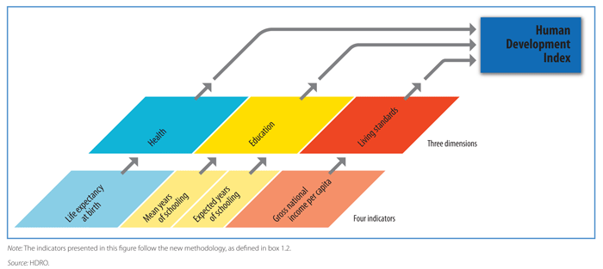
Human Development Index

Slide 3
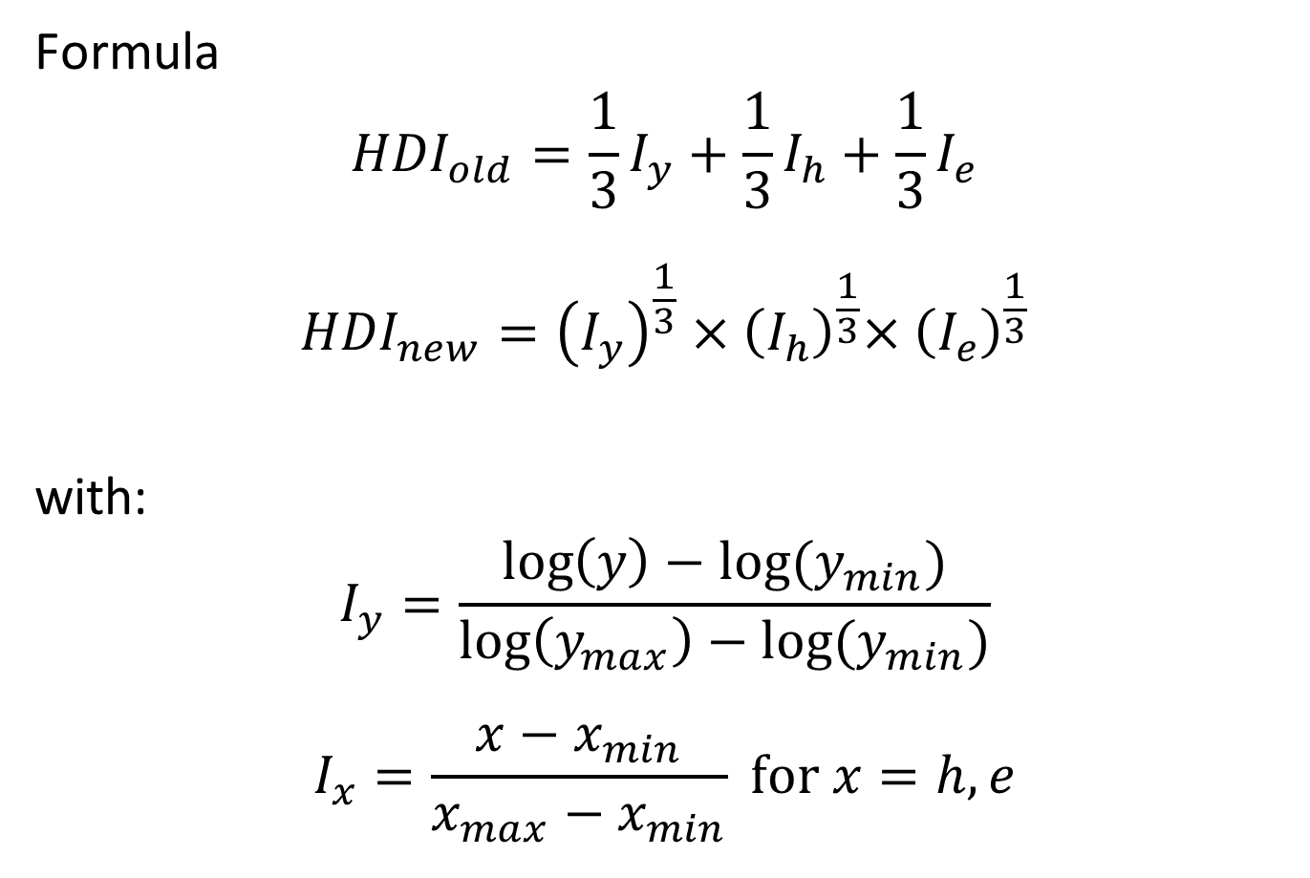
Human Development Index
Formula
$${HDI}_{old}=\frac{1}{3}I_{y}+\frac{1}{3}I_{h}+\frac{1}{3}I_{e}$$
$${HDI}_{new}={\left(I_{y}\right)}^{\frac{1}{3}}{×\left(I_{h}\right)}^{\frac{1}{3}}{×\left(I_{e}\right)}^{\frac{1}{3}}$$
with:
$$I_{y}=\frac{\log\left(y\right)−log⁡(y_{min})}{\log\left(y_{max}\right)−log⁡(y_{min})}$$
$$I_{x}=\frac{x−x_{min}}{x_{max}−x_{min}} \text{for} x=h,e$$

Slide 4

Human Development Index

Slide 5
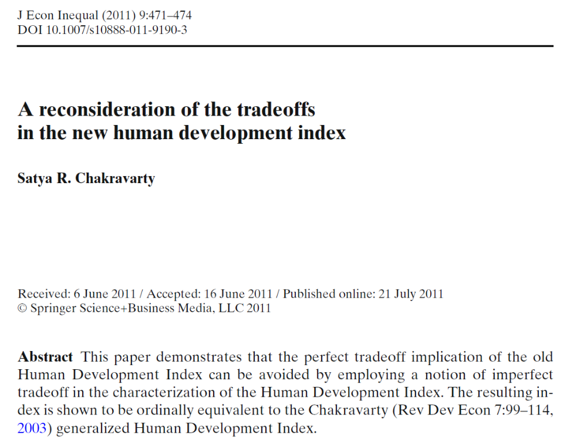
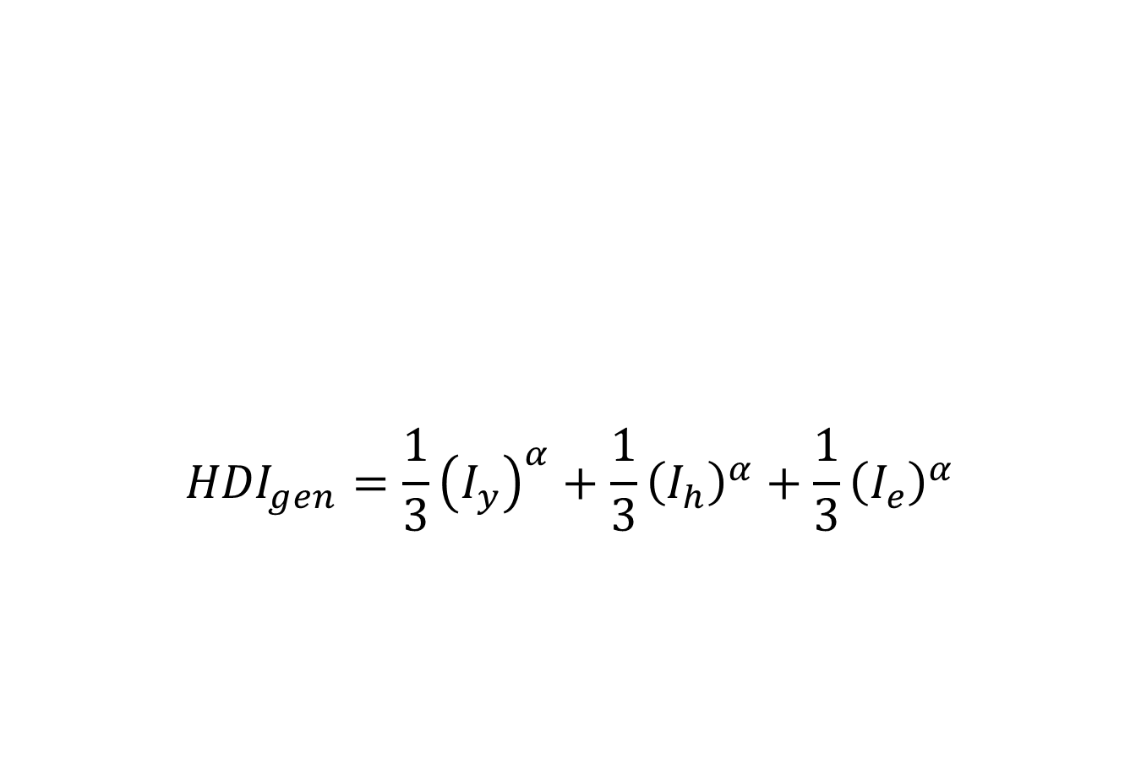
Human Development Index
$${HDI}_{gen}=\frac{1}{3}{\left(I_{y}\right)}^{α}+\frac{1}{3}{\left(I_{h}\right)}^{α}+\frac{1}{3}{\left(I_{e}\right)}^{α}$$
“Thus, instead of looking at the tradeoff as an implication of the formulation, we directly use the tradeoff to derive the functional form” (Chakravarty, 2011, p. 472)

Slide 6
This paper
Discuss how a discrete choice experiment can be used to estimate the tradeoffs respondents make between the dimensions of the HDI
Provide a proof-of-concept with a sample of about 1000 ECON students in four countries (BE, COL, ET, US)

Slide 7
Outline
A super-generalized HDI
Discrete choice approach
Data
Results
Conclusion

Slide 8
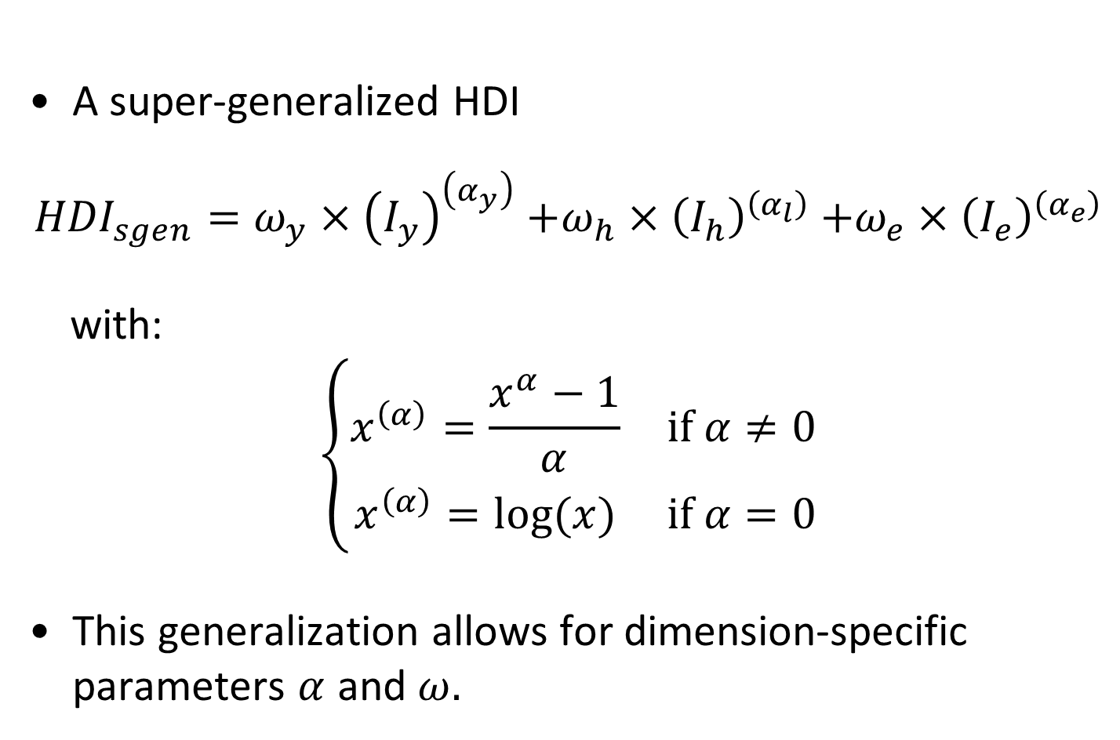
A super-generalized HDI
A super-generalized HDI
$${HDI}_{sgen}=ω_{y}{×\left(I_{y}\right)}^{\left(α_{y}\right)}+ω_{h}{×\left(I_{h}\right)}^{\left(α_{l}\right)}+ω_{e}{×\left(I_{e}\right)}^{\left(α_{e}\right)}$$
with:
$$\left\{\begin{matrix}x^{\left(α\right)}=\frac{x^{α}−1}{α} & \text{if} α≠0 \\ x^{\left(α\right)}=log⁡(x) & \text{if} α=0\end{matrix}\right.$$
This generalization allows for dimension-specific parameters $α$ and $ω.$

Slide 9
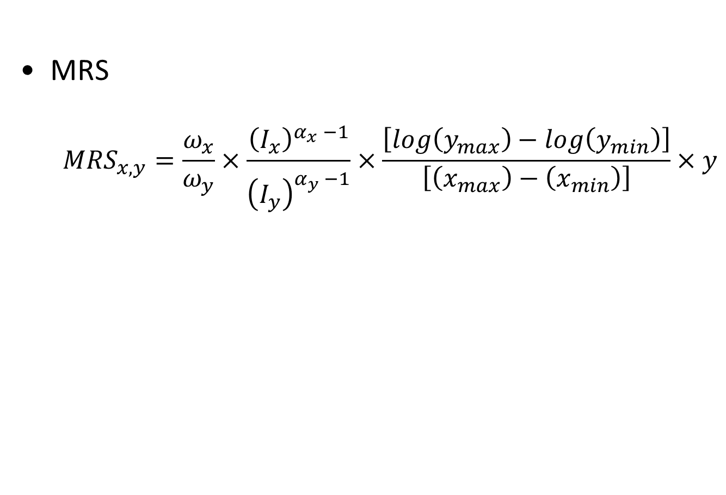
A super-generalized HDI
MRS
$${MRS}_{x,y}=\frac{ω_{x}}{ω_{y}}×\frac{{\left(I_{x}\right)}^{α_{x}^{}−1}}{{\left(I_{y}\right)}^{α_{y}^{}−1}}×\frac{\left[log\left(y_{max}\right)−log\left(y_{min}\right)\right]}{\left[\left(x_{max}\right)−\left(x_{min}\right)\right]}×y$$

Slide 10
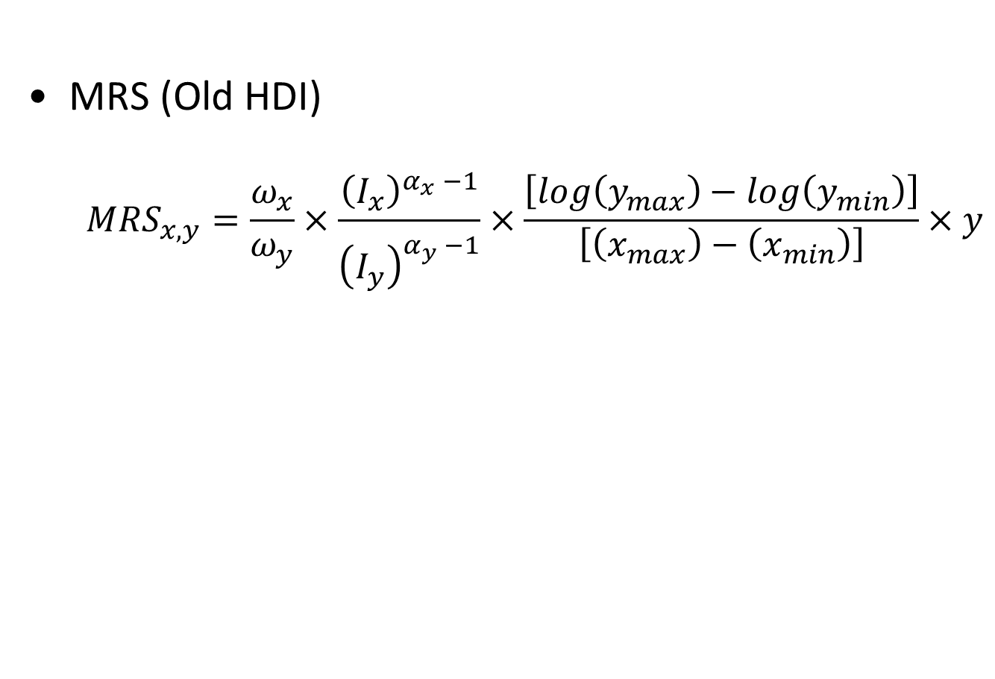
A super-generalized HDI
MRS (Old HDI)
$${MRS}_{x,y}=\frac{ω_{x}}{ω_{y}}×\frac{{\left(I_{x}\right)}^{α_{x}^{}−1}}{{\left(I_{y}\right)}^{α_{y}^{}−1}}×\frac{\left[log\left(y_{max}\right)−log\left(y_{min}\right)\right]}{\left[\left(x_{max}\right)−\left(x_{min}\right)\right]}×y$$

Slide 11
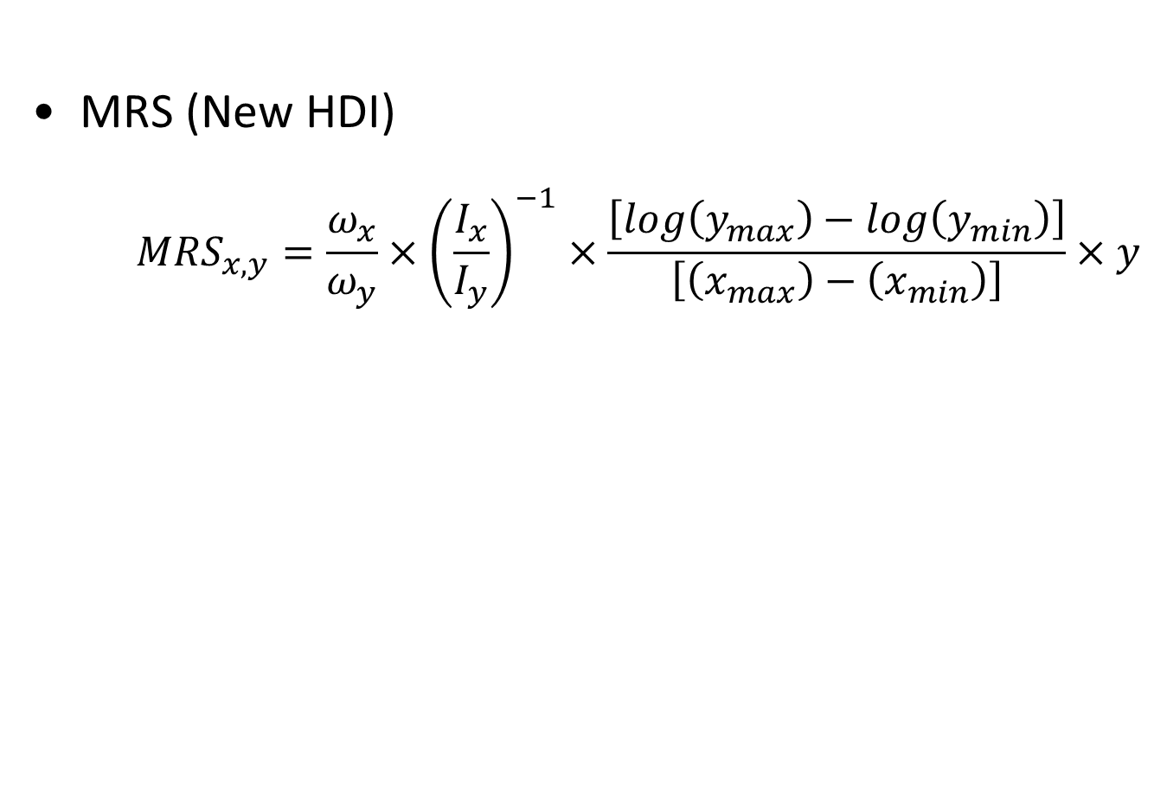
A super-generalized HDI
MRS (New HDI)
$${MRS}_{x,y}=\frac{ω_{x}}{ω_{y}}×{\left(\frac{I_{x}}{I_{y}}\right)}^{−1}×\frac{\left[log\left(y_{max}\right)−log\left(y_{min}\right)\right]}{\left[\left(x_{max}\right)−\left(x_{min}\right)\right]}×y$$

Slide 12
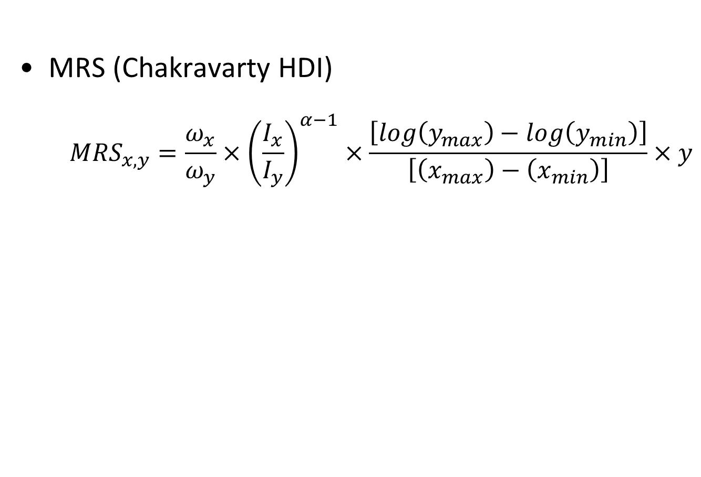
A super-generalized HDI
MRS (Chakravarty HDI)
$${MRS}_{x,y}=\frac{ω_{x}}{ω_{y}}×{\left(\frac{I_{x}}{I_{y}}\right)}^{α−1}×\frac{\left[log\left(y_{max}\right)−log\left(y_{min}\right)\right]}{\left[\left(x_{max}\right)−\left(x_{min}\right)\right]}×y$$

Slide 13
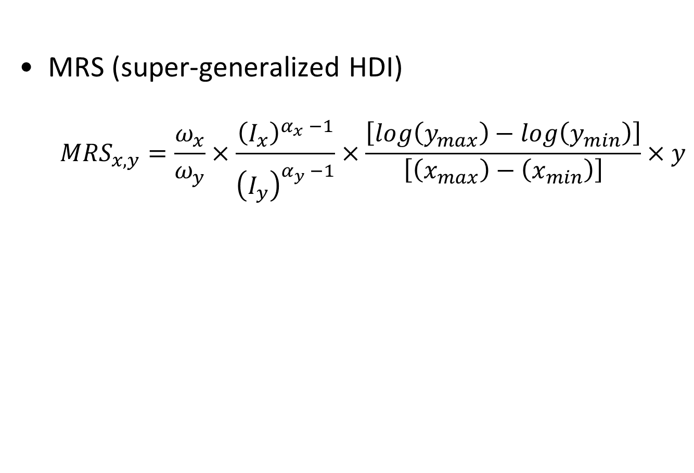
A super-generalized HDI
MRS (super-generalized HDI)
$${MRS}_{x,y}=\frac{ω_{x}}{ω_{y}}×\frac{{\left(I_{x}\right)}^{α_{x}^{}−1}}{{\left(I_{y}\right)}^{α_{y}^{}−1}}×\frac{\left[log\left(y_{max}\right)−log\left(y_{min}\right)\right]}{\left[\left(x_{max}\right)−\left(x_{min}\right)\right]}×y$$

Slide 14
Outline
A super-generalized HDI
Discrete choice approach
Data
Results
Conclusion

Slide 15

Discrete choice approach

Slide 16
Discrete choice approach

Slide 17
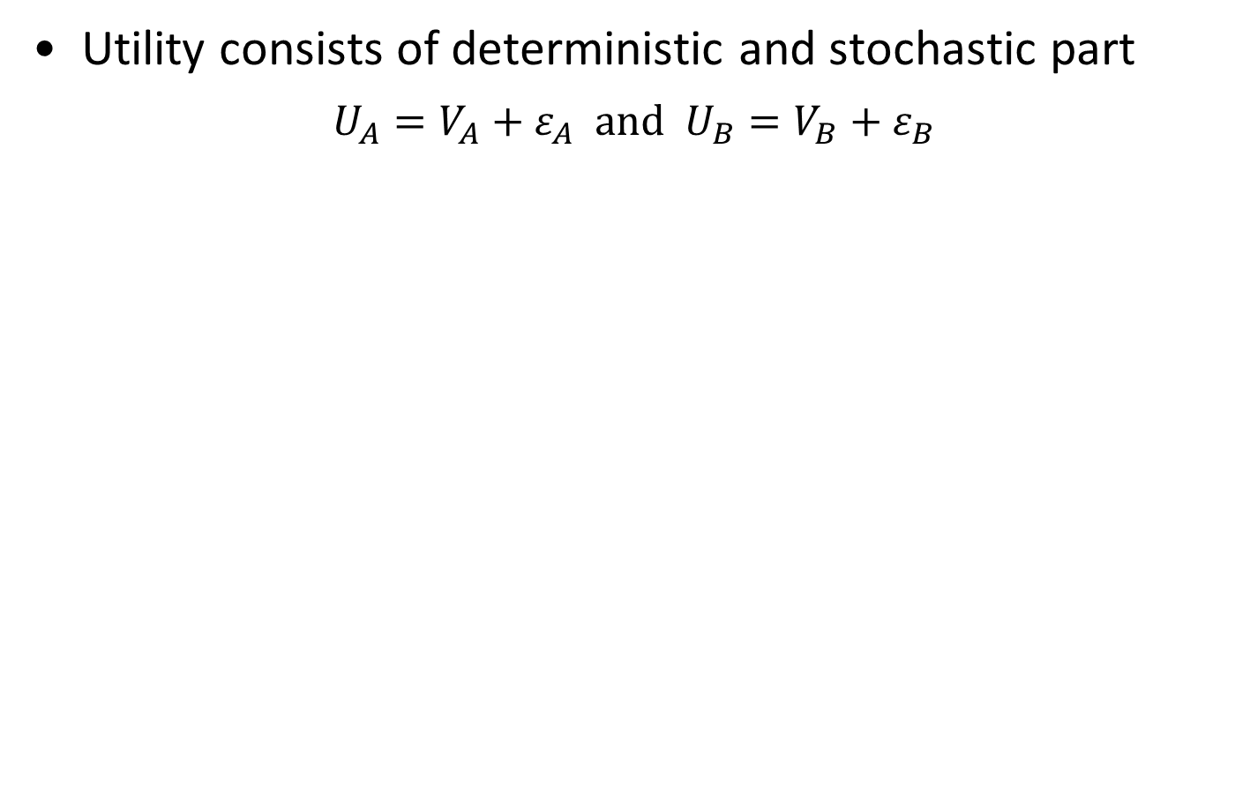
Discrete choice approach: random utility model
Utility consists of deterministic and stochastic part
$$U_{A}=V_{A}+ε_{A} \text{and} U_{B}=V_{B}+ε_{B}$$
Notes:
Verity: probit ? I have been playing with logit …

Slide 18
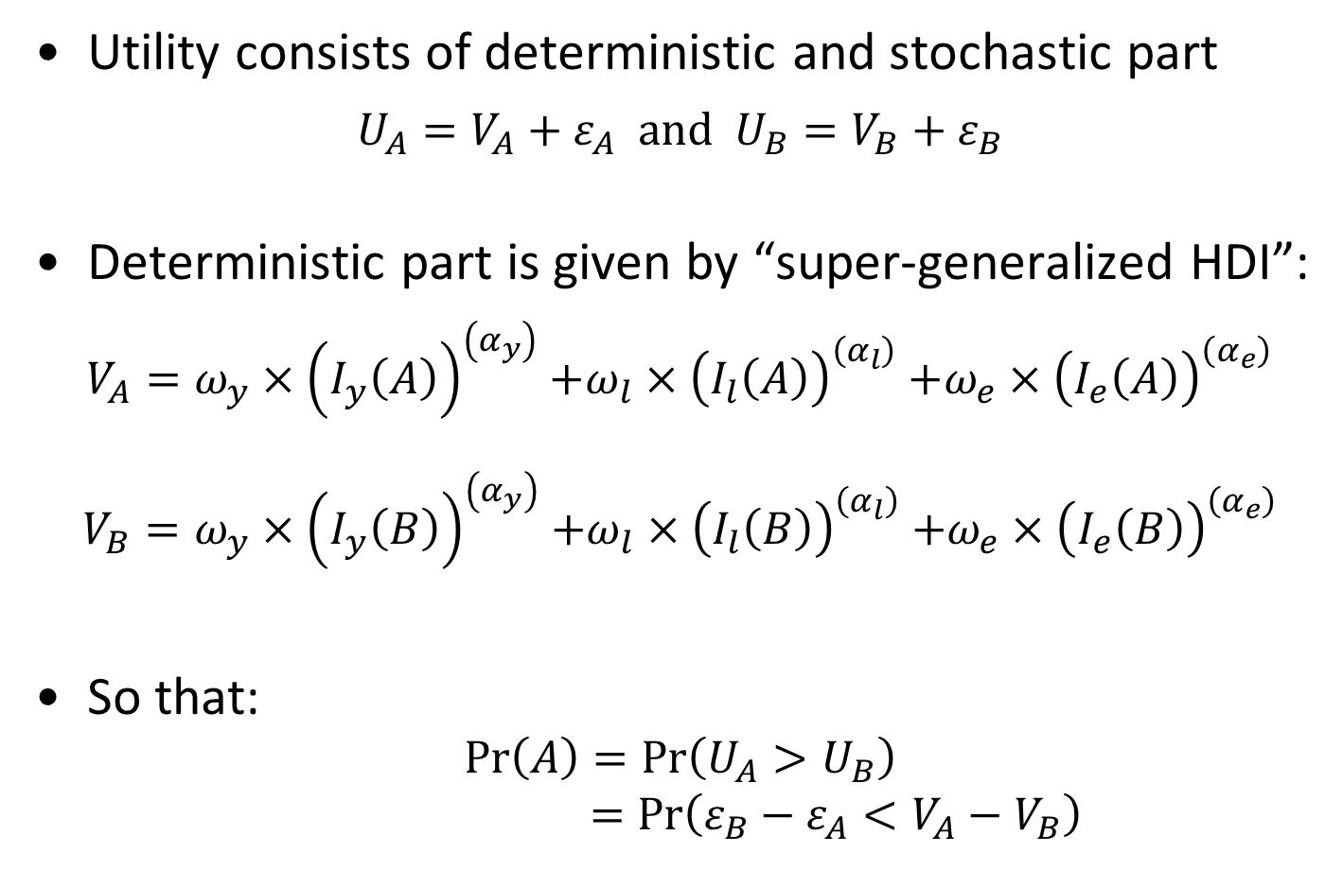
Discrete choice approach: random utility model
Utility consists of deterministic and stochastic part
$$U_{A}=V_{A}+ε_{A} \text{and} U_{B}=V_{B}+ε_{B}$$
Deterministic part is given by “super-generalized HDI”:
$V_{A}=ω_{y}{×\left(I_{y}\left(A\right)\right)}^{\left(α_{y}\right)}+ω_{l}{×\left(I_{l}\left(A\right)\right)}^{\left(α_{l}\right)}+ω_{e}{×\left(I_{e}\left(A\right)\right)}^{\left(α_{e}\right)}$
$$V_{B}=ω_{y}{×\left(I_{y}\left(B\right)\right)}^{\left(α_{y}\right)}+ω_{l}{×\left(I_{l}\left(B\right)\right)}^{\left(α_{l}\right)}+ω_{e}{×\left(I_{e}\left(B\right)\right)}^{\left(α_{e}\right)}$$
So that:
$$\operatorname{Pr}\left(A\right)=\operatorname{Pr}\left(U_{A}>U_{B}\right)$$
$$=\operatorname{Pr}\left({ε_{B}−ε_{A}<V}_{A}−V_{B}\right)$$
Notes:
Verity: probit ? I have been playing with logit …

Slide 19
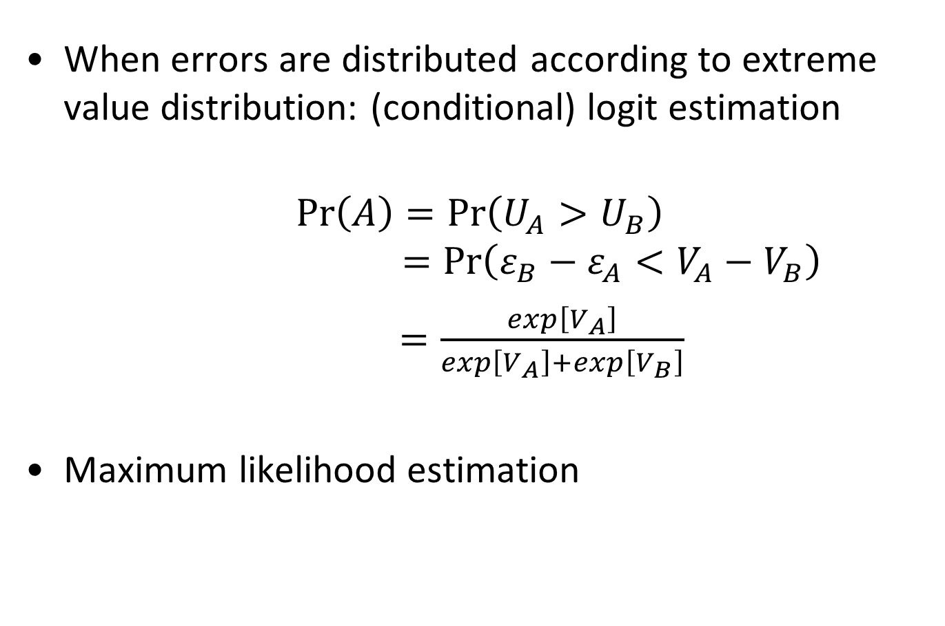
Discrete choice approach: random utility model
When errors are distributed according to extreme value distribution: (conditional) logit estimation
$$\operatorname{Pr}\left(A\right)=\operatorname{Pr}\left(U_{A}>U_{B}\right)$$
$$=\operatorname{Pr}\left({ε_{B}−ε_{A}<V}_{A}−V_{B}\right)$$
$=\frac{exp\left[V_{A}\right]}{exp\left[V_{A}\right]+exp\left[V_{B}\right]}$
Maximum likelihood estimation

Slide 20
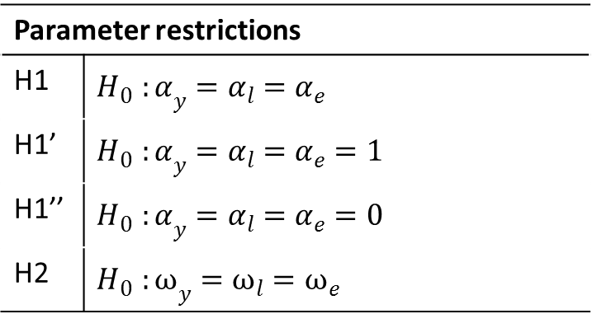
Discrete choice approach: random utility model
Parameter restrictions can be tested with Likelihood Ratio tests
Parameter restrictions
H1 | $${H_{0}^{}:α}_{y}=α_{l}=α_{e}$$
H1’ | $${H_{0}^{}:α}_{y}=α_{l}=α_{e}=1$$
H1’’ | $${H_{0}^{}:α}_{y}=α_{l}=α_{e}=0$$
H2 | $${H_{0}^{}:ω}_{y}=ω_{l}=ω_{e}$$

Slide 21
Outline
A super-generalized HDI
Discrete choice experiments
Data
Results
Conclusion

Slide 22
Data
Paper-and-pencil questionnaire among ECON students
Non-representative sample
“Proof of concept”
Country | Date | University | N | Age | Male
BE | Oct. 17, 2014 | Univ. of Antwerp | 470 | 18,68 | 39,44%
CO | Nov. 15, 2014 | Univ. ICESI, Cali | 205 | 20,27 | 53,17%
ET | April 17, 2015 | Addis Ababa Univ. | 249 | 28,70 | 62,34%
US | Sept. 19, 2015 | Princeton Univ. | 98 | 20,29 | 52,04%

Slide 23
Discrete choice approach: implementation
Respondents make 9 + 3 pairwise choices
Dimensions take 3 levels (actual p20, p50, and p80)
Country | Dimension | p20 | p50 | p80
BE | Income per person (in euro) | 750 | 1100 | 1600
 | Life expectancy (in years) | 70 | 80 | 90
 | Education attainment (in years) | 9 | 12 | 15
COL | Income per person (in 1000 peso) | 75 | 180 | 400
 | Life expectancy (in years) | 60 | 75 | 85
 | Education attainment (in years) | 2 | 6 | 11
ET | Income per person (in Birr) | 600 | 1000 | 1500
 | Life expectancy (in years) | 20 | 45 | 75
 | Education attainment (in years) | 2 | 6 | 12
US | Income per person (in $) | 650 | 1700 | 3500
 | Life expectancy (in years) | 70 | 80 | 90
 | Education attainment (in years) | 8 | 11 | 13

Slide 24
Outline
A super-generalized HDI
Discrete choice experiments
Data
Results
Conclusion

Slide 25
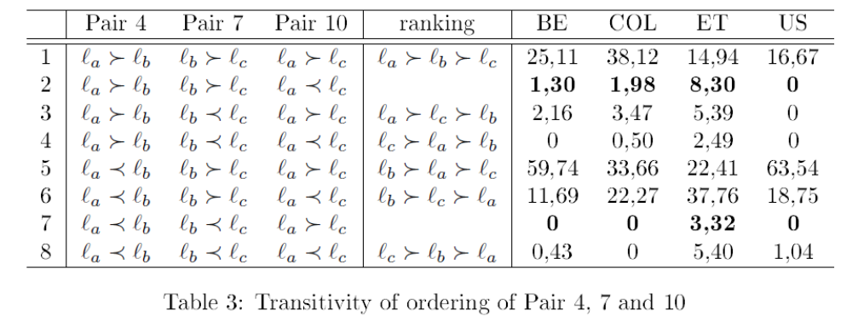
Are responses transitive?

Slide 26
Are responses transitive?

Slide 27
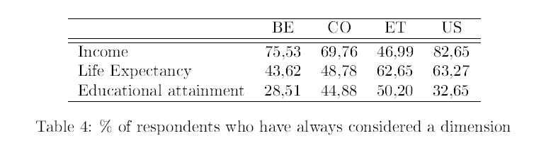
Compensatory decision making?

Slide 28
Outline
A super-generalized HDI
Discrete choice experiments
Data
Results
Conclusion

Slide 29
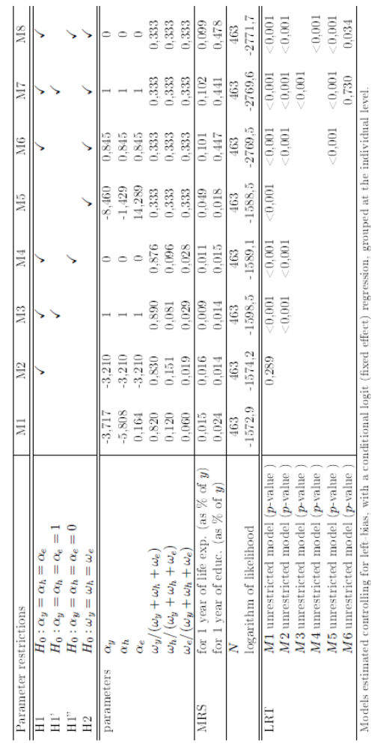
Belgium

Slide 30
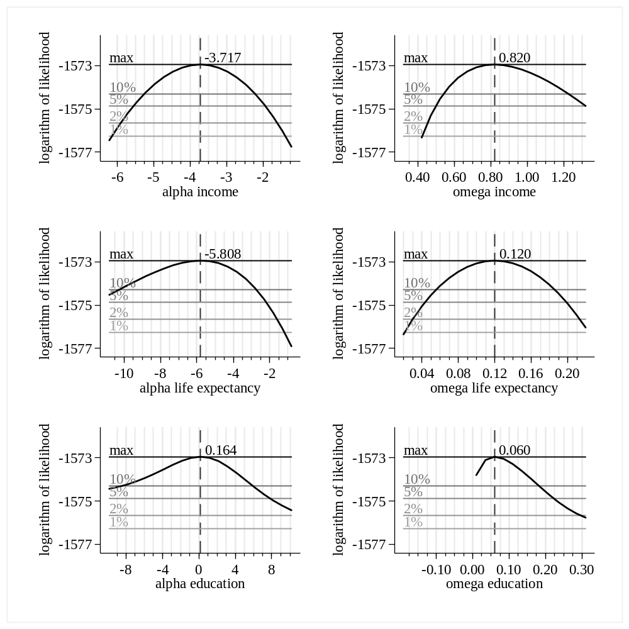
Belgium

Slide 31
Belgium

Slide 32
Belgium

Slide 33
Belgium

Slide 34
Belgium

Slide 35
Belgium

Slide 36
Belgium

Slide 37
Belgium

Slide 38
Belgium
Weights are not equal
Curvature parameters may be equal (but not equal to 0 or 1; rather -3)
WTP for 1 year of life expectancy: 1,5% of income
WTP for 1 year of education: 2,4% of income

Slide 39
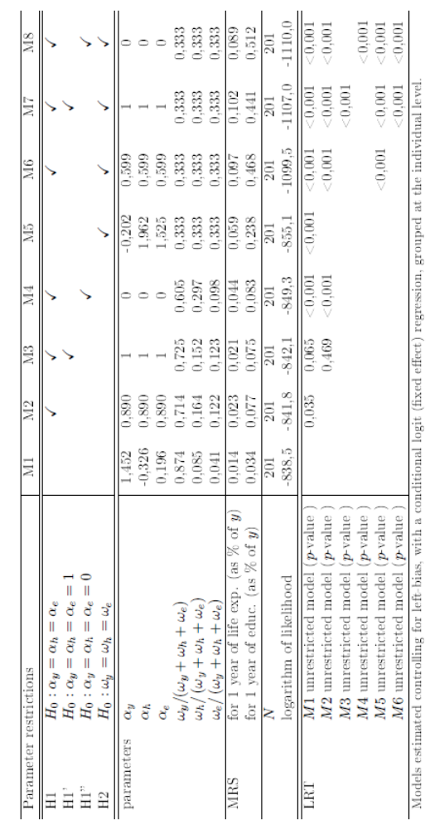
Colombia

Slide 40
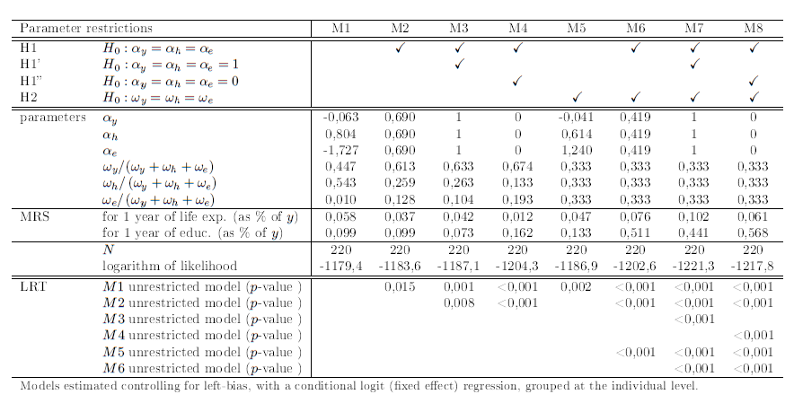
Ethiopia

Slide 41
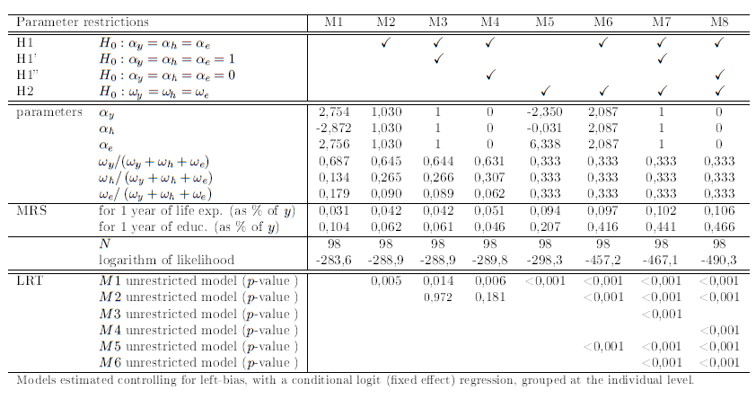
United States

Slide 42
Conclusion
Proof-of-concept
Discrete choice experiments seem a useful tool to determine the weights of a well-being index
Formulating the experiment in a cross-country comparable way is challenging
Equal weights are rejected, most subsamples reject equal curvature parameters

Slide 43
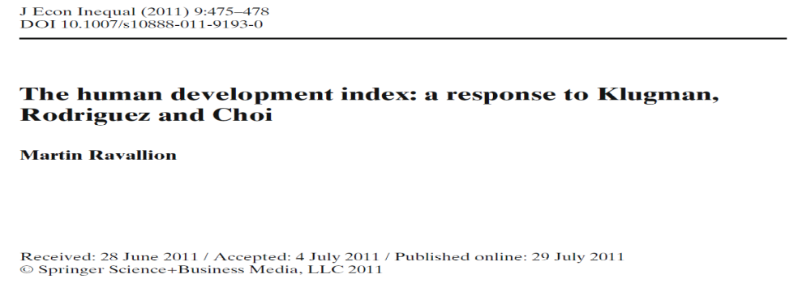
Conclusion
“Hopefully this debate will lead both users and producers of the HDI to think more critically in the future about what tradeoffs the index should assume in specific country settings” (Ravallion, 2011, p. 478)

Slide 44

Results: weights for Belgium different framing

Slide 45
Results: weights for Belgium different framing
Inspired by Benjamin et al. 2012 (AER)

Slide 46
Results: weights for Belgium different framing
233 respondents get both questions
 |  | Life Satisfaction
 |  | A | B
Preference | A | 1158 (42%) | 147 (6%) | 1305
 | B | 177 (6%) | 1263 (46%) | 1440
 |  | 1335 | 1410 | 2745

Slide 47
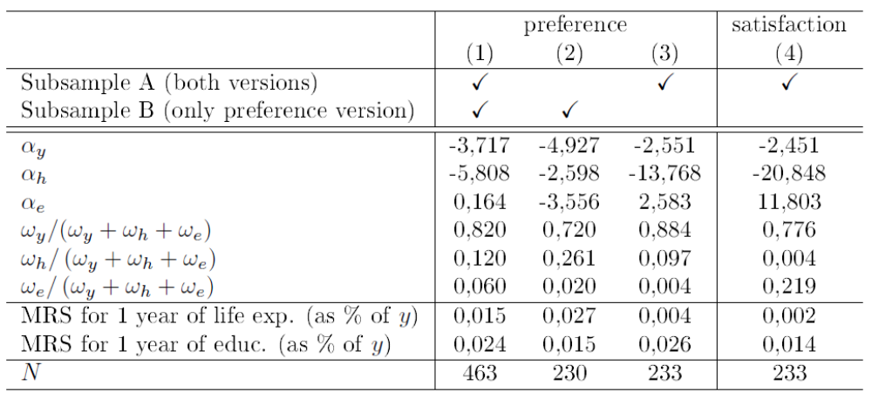
Results: weights for Belgium different framing

